Slide 1
Unbalanced 2-Way ANOVA Based on Summary Statistics
Ethics by Gender and Rank Among Members of the Coast Guard
R.D. White, Jr. (1999). “Are Women More Ethical? Recent Findings on the Effects of Gender Upon Moral Development,” Journal of Public Administration Research and Theory, Vol 9, #3, pp.459-471.

Slide 2
Statistical Model
2 Factors: A (a levels), B (b levels)
n_{ij} when Factor A @ level I, B @ j
Model:
  Y_{ijk} = μ + α_{i} + β_{j} + (αβ)_{ij} + e_{ijk} = μ_{ij} + e_{ijk}
  Where:
  e_{ijk} ~ N(0 , σ²) (independent)
  α_{i} ≡ Effect of level i of Factor A
  β_{j} ≡ Effect of level j of Factor B
  (αβ)_{ij} ≡ Effect if Interaction of A @i, B @j

Slide 3
Background
Comparison of DIT Scores among members of Coast Guard (Higher scores considered higher moral standards)
2 Factors:
  Factor A: Gender (2 Levels – Male, Female)
  Factor B: Rank (2 Levels – Officer, Enlisted)
Subjects:
  72 Male Officers
  15 Female Officers
  180 Male Enlistees
  32 Female Enlistees

Slide 4
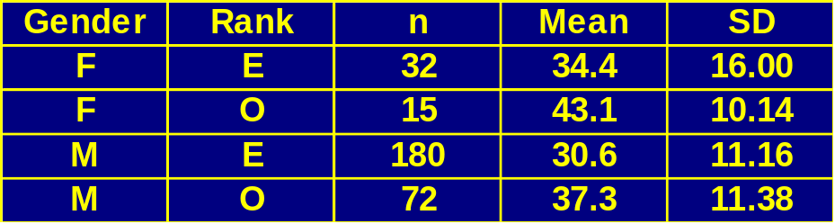
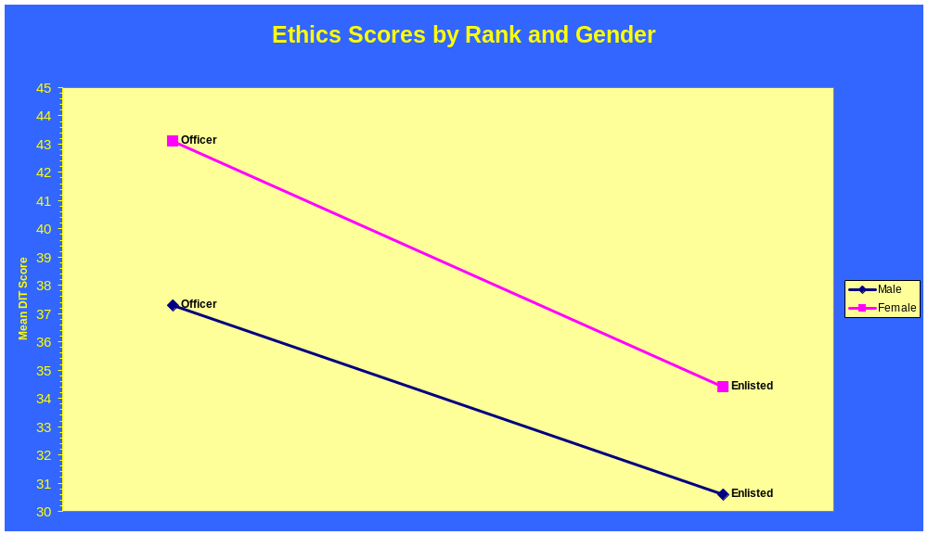
Summary Statistics

Slide 5
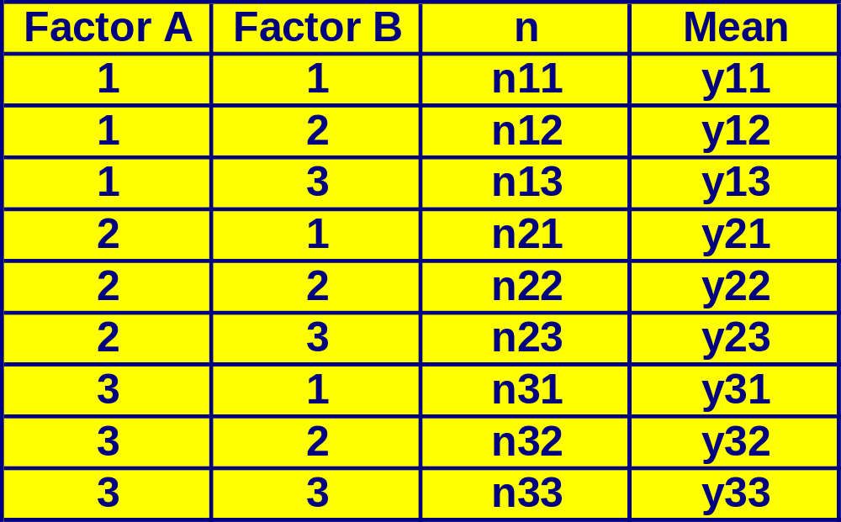
Coding for ANOVA (I)
Factor A @ a levels, B @ b levels
Special Case: a = 3, b = 3. Structure of “Data”:

Slide 6
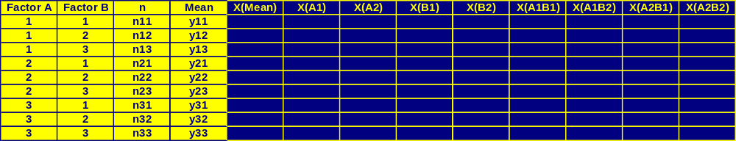
Coding for ANOVA (II)
Create “X-matrix” with ab rows and:
  1 Column for Mean
  a - 1 Columns for Factor A
  b - 1 Columns for Factor B
  (a – 1)(b – 1) for AB Interaction

Slide 7
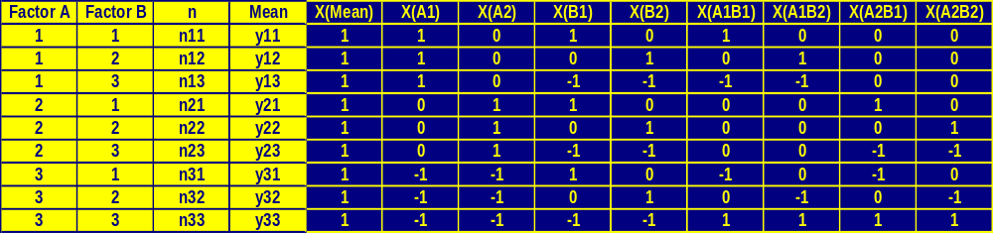
Coding for ANOVA (III)
Step 1: Mean – Enter 1 for Each Row
Step 2: Factor A
  Factor A is at level “i “ , Put 1 for X(Ai)
  Factor A is not at level “i” or “a”: Put 0 for X(Ai)
  Factor A is at level “a”: Put -1 for X(Ai)
Step 3: Factor B – Just like Factor A
Step 4: Factor AB:
  Take Product of X(Ai) and X(Bj) to get X(Ai,Bj)

Slide 8
Coding for ANOVA (IV)
Create a (ab)x(ab) matrix where the (i,j)^{th} element is the sum of the products of the “n” column, and the i^{th}, and j^{th} Columns of the “X-matrix” ≡ X’X
Create a (ab)x1 vector where the i^{th} element is the sum of the products of the “n” column, the “mean” column and the i^{th} Column of “X-Matrix” ≡ X’Y
The full and sub-matrices of X’X and X’Y are used to construct various sums of squares for tests

Slide 9

Matrices for ANOVA (I)

Slide 10

Matrices for ANOVA (II)

Slide 11

ANOVA – Total Sum of Squares

Slide 12
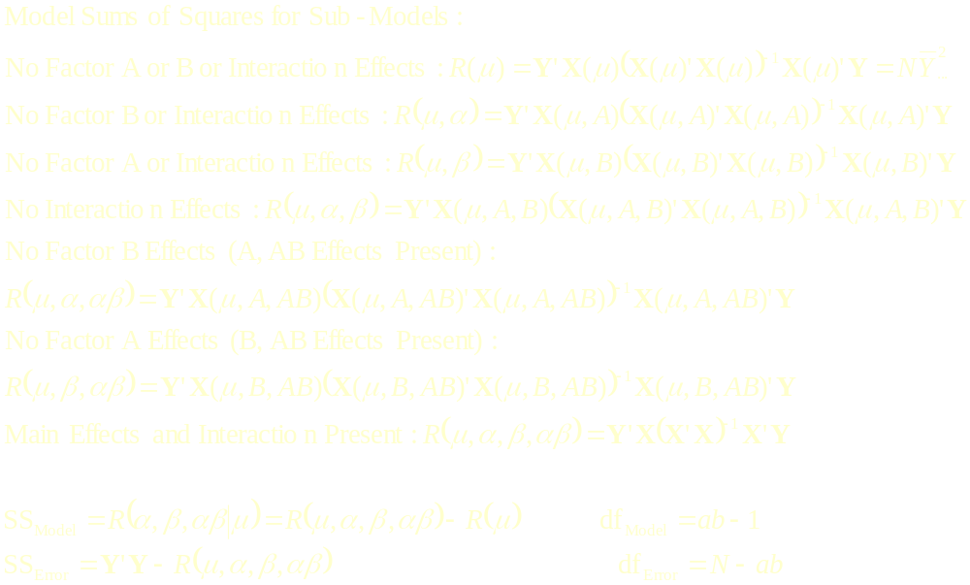
ANOVA – Model and Error SS

Slide 13

ANOVA – Tests, Type III Sum of Squares

Slide 14
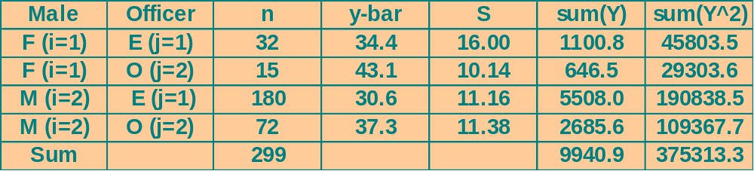
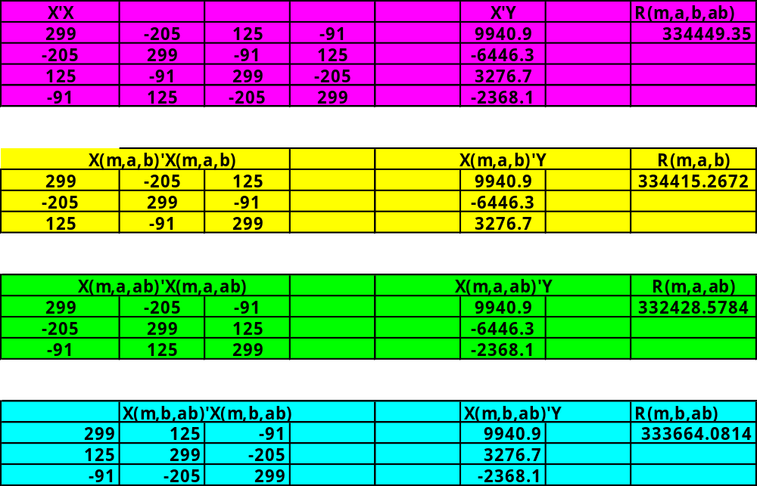
Application – Coast Guard Ethics

Slide 15
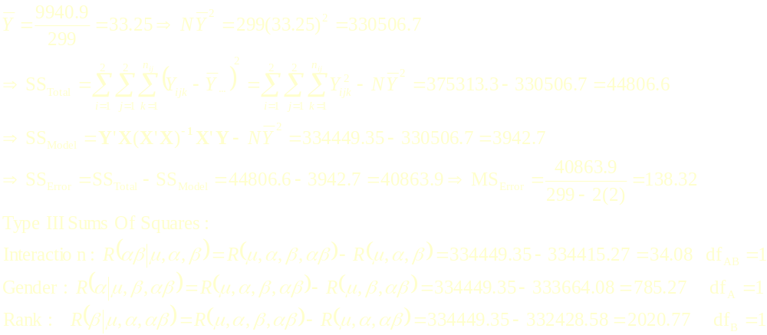
Application – Coast Guard Ethics
Factor | F-Statistic | Rej. Region | P-Value
Interaction | F_{AB} = 0.25 | F_{AB} ≥ F_{.05,1,295}=3.87 | .6175
Gender | F_{A} = 5.68 | F_{A} ≥ F_{.05,1,295}=3.87 | .0178
Rank | F_{B} = 14.61 | F_{B} ≥ F_{.05,1,295}=3.87 | .0002

